Slide 1
LOYOLA MEN’S HOSTEL MANAGEMENT SYSTEM VIGNESH.V [23021U09049]
Prof. J. KALAIYARASI., MCA.,
Asst Professor, Department of Computer Applications
Loyola College, Vettavalam.

Slide 2
ABSTRACT
This project aims to develop a dynamic and visually appealing website for a hostel, The Loyola Men’s Hostel Management System (LMHMS) is a comprehensive web-based application designed to streamline the management of hostel facilities. It provides an efficient platform for hostel administrators, managers, and residents to handle various tasks related to hostel operations. The system offers functionalities for hostel booking, room allocation, resident management, maintenance requests, and administrative tasks.
The primary objective of LMHMS is to automate and simplify hostel management processes, thereby enhancing efficiency and user experience. Through an intuitive web interface, hostel administrators can manage hostel information, including room availability, pricing, and rules. Residents can conveniently access the system to check room availability, make bookings, and submit maintenance requests

Slide 3
Problem Statement
Hostel management is often a complex and time-consuming process, involving numerous tasks such as room allocation, resident management, maintenance handling, and administrative duties. Traditional methods of managing hostels using manual processes or outdated software systems can lead to inefficiencies, errors, and a poor user experience for both administrators and residents.

Slide 4
Proposed System
Site users enter check in date and check out date then search for availability and rates. After choosing the right room in the wanted hostel – all booking and reservation process is done on the site and an SMS is sent to confirm the booking.

Slide 5
Hardware Requirements & Software Requirements
Hardware Requirements
Software Requirements
PROCESSOR : AMD RYZEN 5 5600G
HARD DISK : 1 TB
SSD : 256 GB
RAM : 16 GB DDR4 3600 MHz
OPERATING SYSTEM : Windows10
FRONT-END : HTML, CSS, JavaScript
BACKEND-END : PHP, MySQL
SOFTWARE : XAMPP, VS CODE

Slide 6
List of Modules
1) Home 2) About 3) Gallery 4) Team 5) Contact us 6) Newsletter 7) Payment Receipt 8) Reservation 9) Payment method

Slide 7
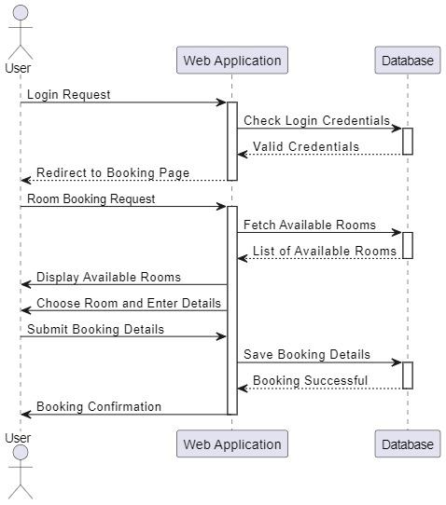
Sequence Diagram

Slide 8
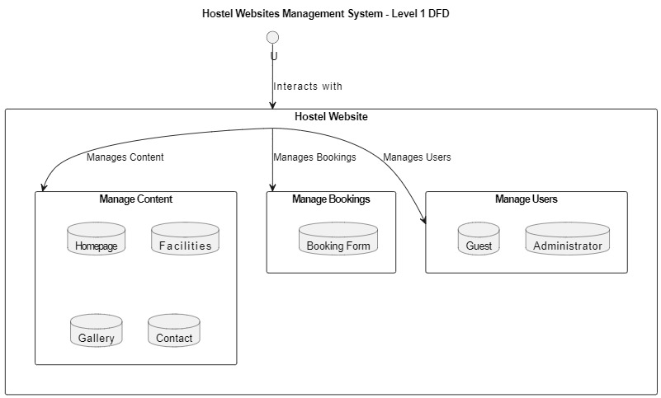
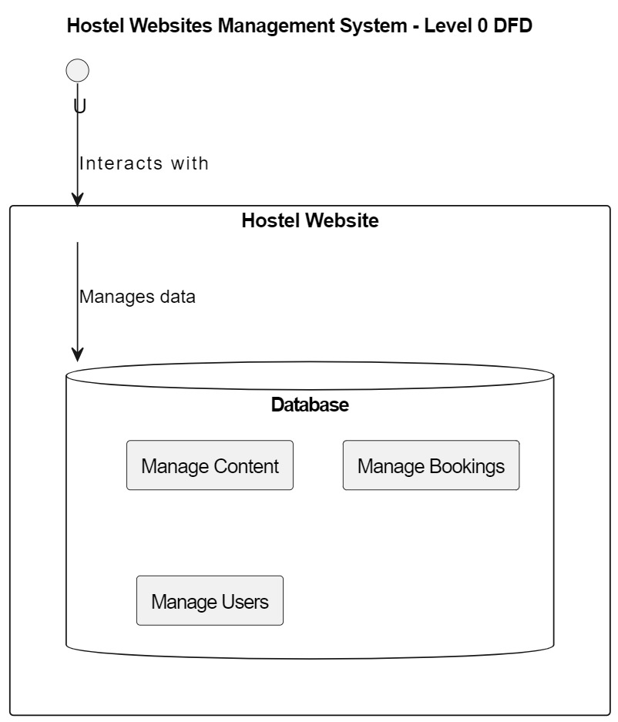
Data Flow Diagram

Slide 9
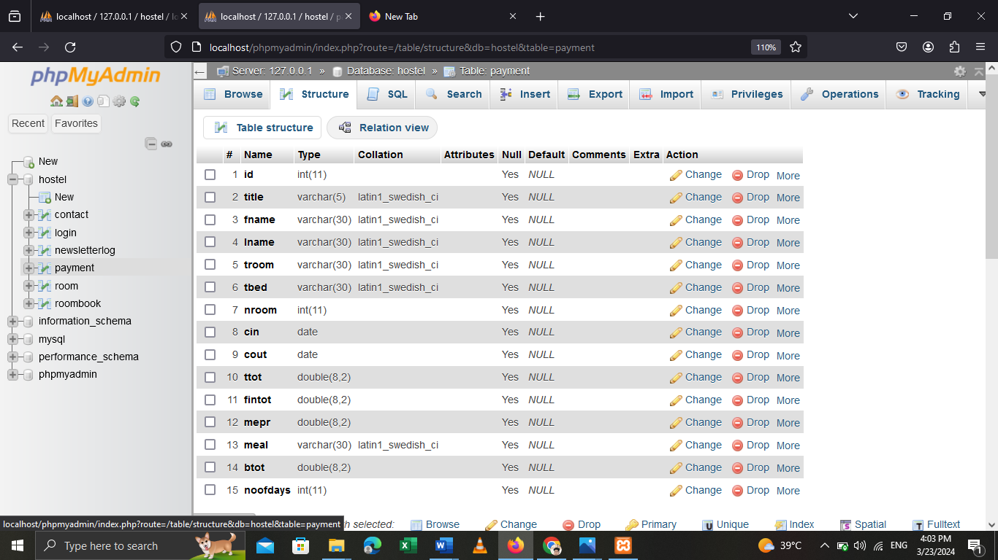
Database Table Design

Slide 10
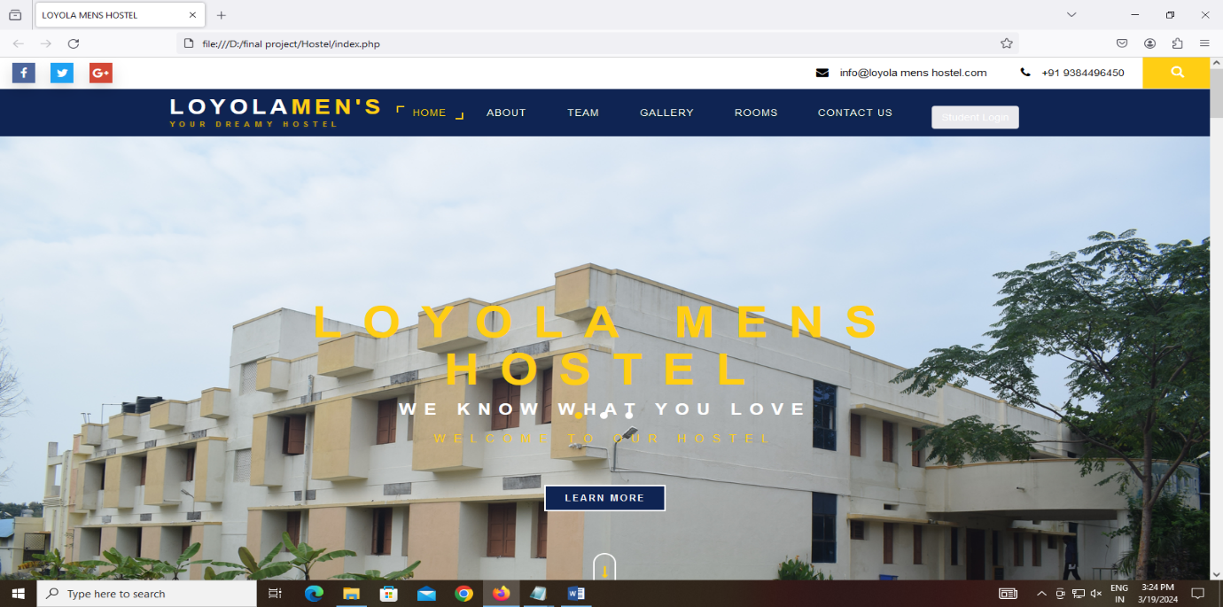
Screenshot

Slide 11
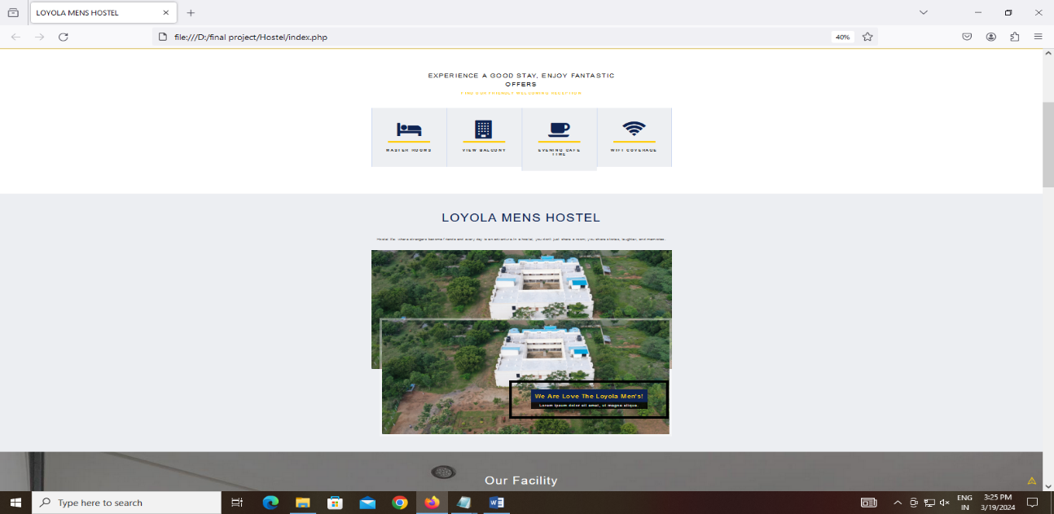

Slide 12
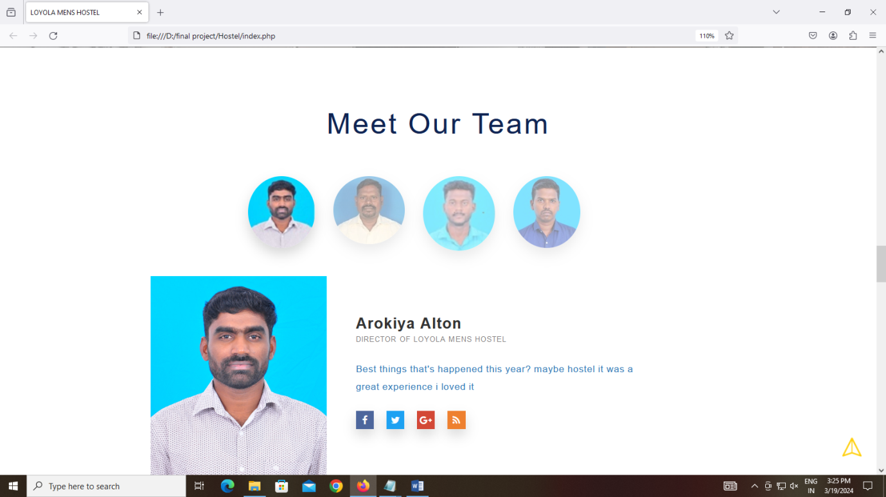

Slide 13
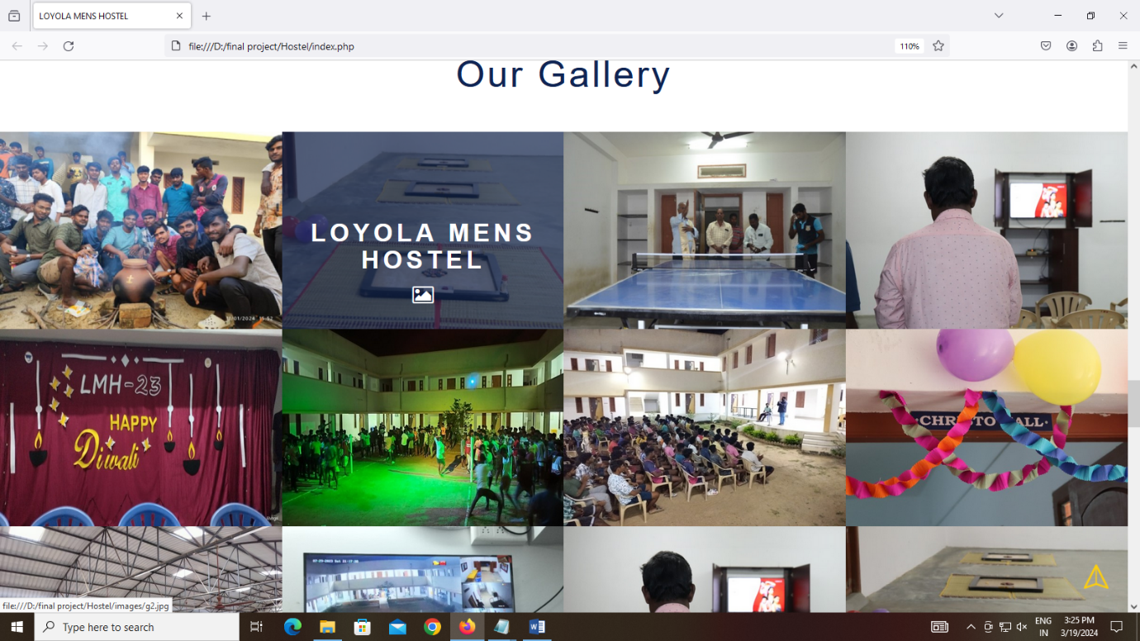

Slide 14
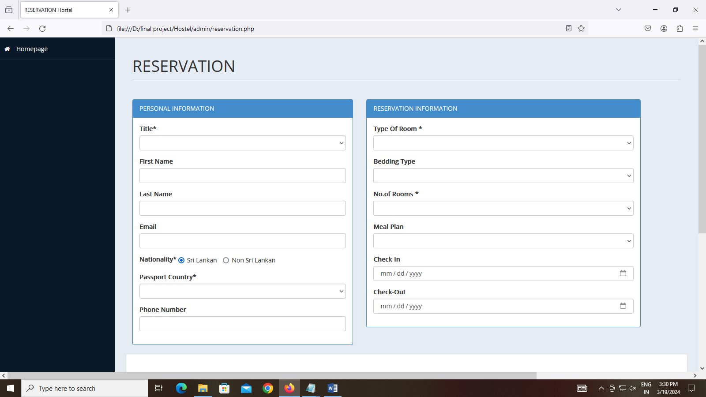

Slide 15
Future Scope
Enhanced Mobile Experience:
Virtual Reality (VR) and Augmented Reality (AR) Applications:
Develop mobile apps with advanced features such as mobile check-in/check-out, digital room keys, and in-app messaging for seamless communication between guests and staff.
Implement mobile payment solutions and digital wallets for convenient and contact less transaction.
Develop VR and AR applications for virtual tours of hostel facilities, allowing potential guests to explore rooms and amenities remotely.
Use AR for interactive maps and navigation within the hostel premises, providing guests with directions and information about nearby attractions.

Slide 16
Conclusion
Ultimately, the hostel website management system is more than just a software platform—it's a catalyst for transformation, empowering hoteliers to create memorable stays for their guests while maximizing operational efficiency and profitability. With the right tools and strategies in place, the future of hostel management is boundless, promising a world of possibilities for hostel owners, managers, and guests alike.

Slide 17
Thank you

